Slide 1
ASSIGNMENT- INTRODUCTION TO TABLEAU
Submitted By: Pooran Pragnya
November Batch (BDS)

Slide 2
BUSINESS INTELLIGENCE TOOL (BI TOOL)
These are types of application software which collects and process large amounts of unstructured data from internal and external systems including books, journals, documents, health records, images, files, emails, videos and other business sources.
These tools also helps us to prepare data for analysis so that we can create reports and data visualization (pictorial representation of data).
BI tools provide a way of amazing data to find information primarily through queries.

Slide 3
Some of the most widely used BI Tools:
Zoho analytics
Tableau
BiG EVAL
Power BI
Qlikview
Logility etc

Slide 4
TABLEAU
It is a data visualization tool or business intelligence tool which analysis and shows data in the form of a chart/report. It is very easy to use because it doesn’t require any programming skill.
It is a powerful data visualization tool, helps us to analyze the raw data in pictorial form or in the form of visual manner it may be graph, report etc.
Data analysis is very fast with tableau and the visualization created are in the form of worksheet and dashboards.

Slide 5
It is an American interactive data visualization software company focused on business intelligence. It was founded in 2003 in Mountain view, California and is currently headquartered in Seattle.
Various prominent organizations around the world like Verizon, Linkedin, Honeywell, Lenovo etc are using Tableau for Data analysis and visualization.
It finds application in almost every filed like enterprise, IT, Finance, Marketing, Sales, Human resources, supply chain etc.

Slide 6
Tableau Installation Guide
https:// www.tableau.com/
Select product Menu – select Tableau desktop
Click on trail it for free option
Provide your email id and click on download free trail
This will start downloading the .exe file for window machine by default
Open the download file and click on the ‘Run’ button
Accept the terms and conditions and click on ‘install’ button

Slide 7
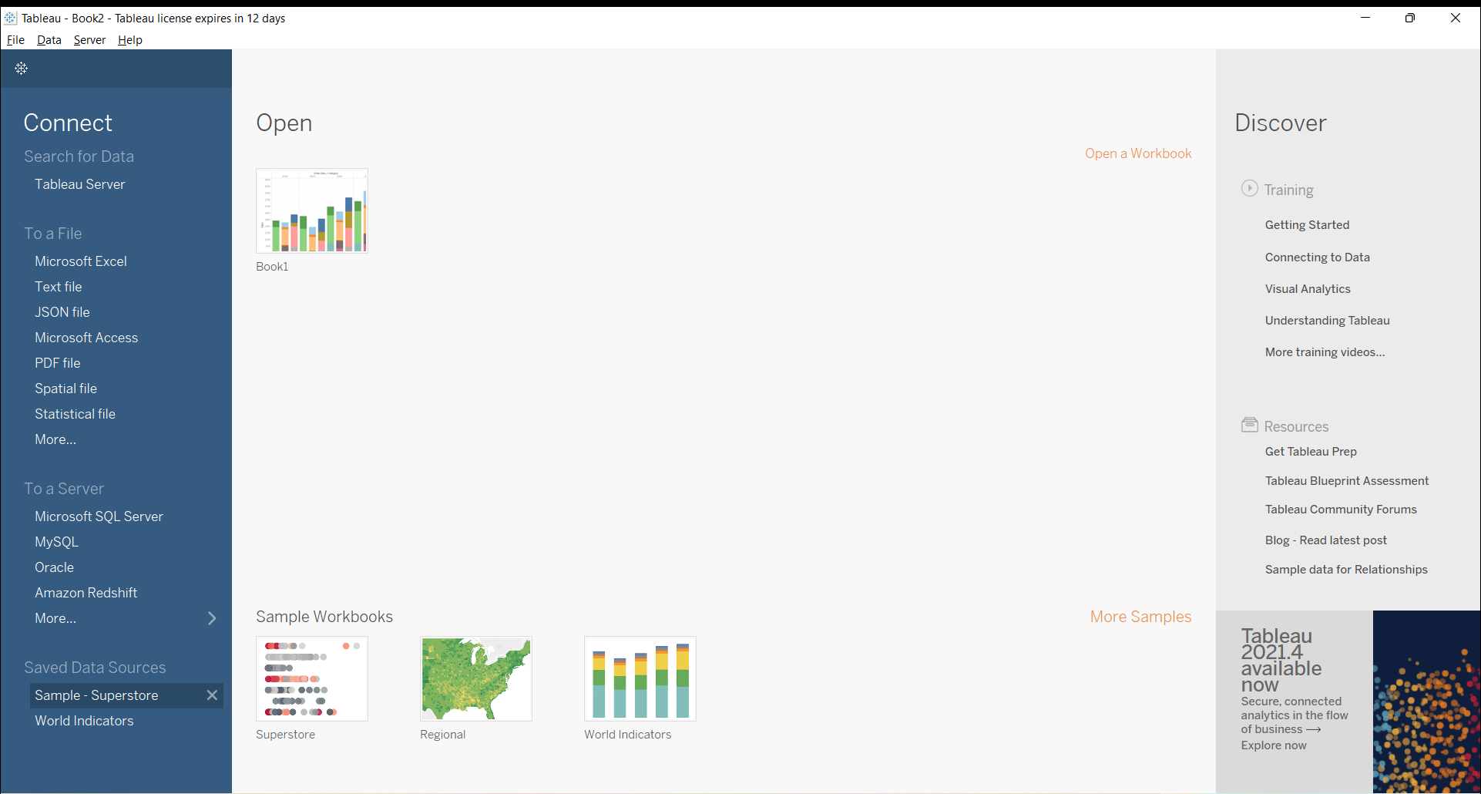

Slide 8
Components of Start Page
Connect: Connect station allows tableau to connect with desktop files (different file types) and different database type. Files can be MS, Excel, PDF, CSV, JSON file etc.
Open: You can open your existing workbook or workbook in which you have worked earlier.
Discover: In the discover section, we get short tutorial provided by tableau community. Here we can find important blogs or some important work done by all contributor in tableau community.

Slide 9
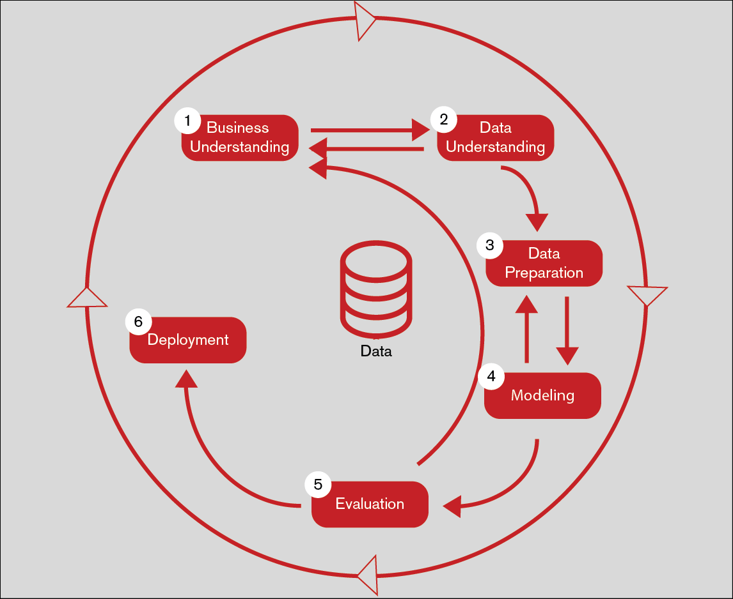
Process Flow – BI Project

